Slide 1
A Deep Dive into Deep Learning
Alexander Baker

Slide 2
What is Deep Learning
Deep learning is a subset of machine learning that mimics the neural connections within the brain
The algorithm is structured in layers, where data is input, goes through a hidden layer, and is output
Since deep learning is based off of the human brain, it can preprocess a wide variety of human stimuli
Deep learning is known to adjust well to a larger volume of data, however may be problematic with smaller datasets
Though discovered in the 1950s, neural networks have become popular due to the current renaissance of big data technologies

Slide 3
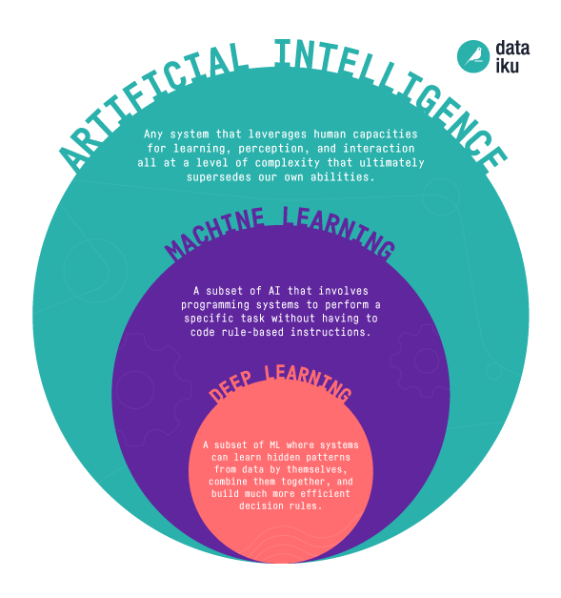
Differences Between Deep and Traditional ML
Artificial intelligence is a general term referring to the general ability for a computer to mimic human intelligence
Machine learning is a subset of artificial intelligence that extracts knowledge form data to make decisions without being explicitly programmed
Deep learning is a subset of machine learning that mimics the human brain
This group of algorithms requires more computational power and data, but its architecture can prove to be more sophisticated than traditional machine learning
Deep learning can preprocess unstructured data without the need of human intervention
These algorithms are notoriously “black-box”

Slide 4
Neural Network Terminology
Layer - The main components that comprise a neural network. They are a collection of neurons that take in an inputs and produce an output
Neuron - A singular node that takes in inputs multiplies them by weights, adds a bias, and produces an aggregated output
Forward-propagation - The architecture of the neural network where the outputs of one layer become the inputs of the next layer until an output is produced
Back-propagation - The difference between the neural network’s output and the validation value is used to update the weights of each layer
Activation Function - A function used to determine whether a neuron fires or not. This is used to add a non-linear element into the otherwise linear neural network, adding a level of sophistication
Loss function - A method used to evaluate how well the algorithm models the data
Optimizer - An algorithm that modifies the parameters of the neural network with the intention of reducing error

Slide 5
Neural Network Terminology
Input Layer - The starting layer of a neural network that requires an input dimension, it takes the raw input and produces the first output
Hidden Layer - Center layers of a neural network, they take the output of a previous layer and create an input for the next layer
Output Layer - The final layer of the neural network, they take the output from the previous layer and create the output for the neural network
Batch Size - A piece of the total dataset selected for training
Epoch - Number of times the model trains on the entire dataset
Iteration - Number of batches to complete training over one epoch

Slide 6
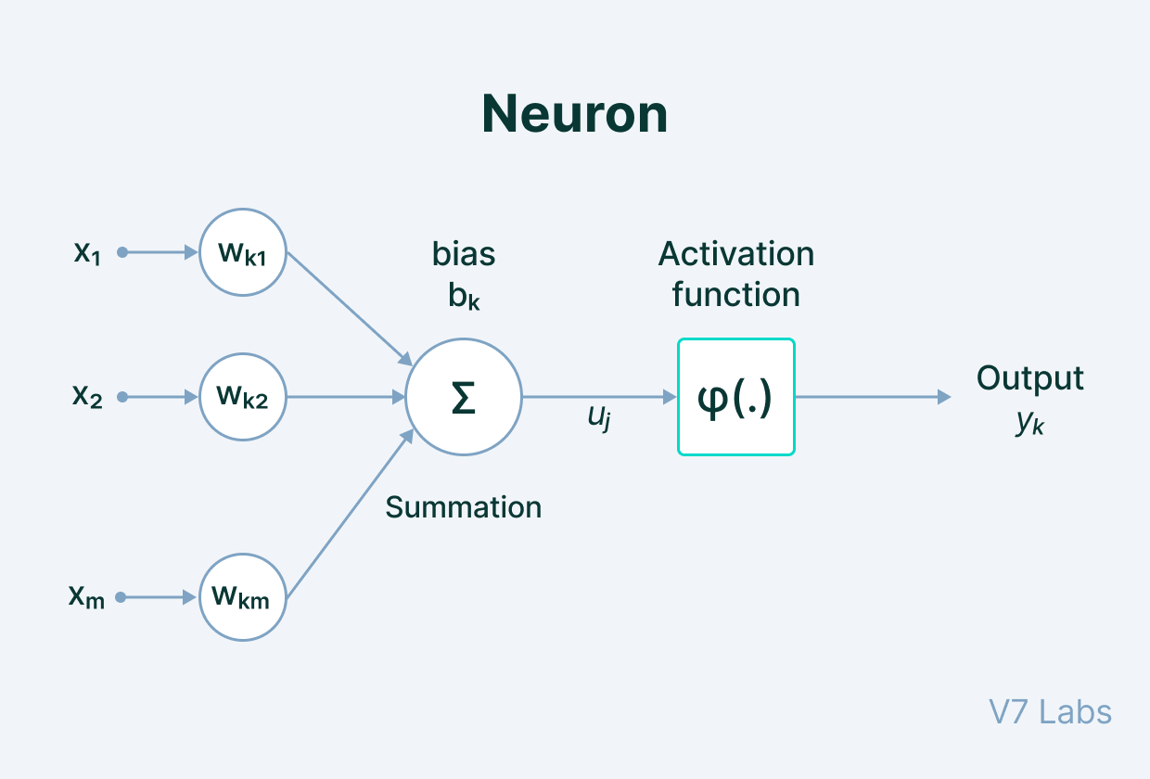
Artificial Neural Network Architecture
This is the vanilla neural network
In this example the network will be fully connected
This means the output of each neuron from a previous layer will be an input for each neuron within the next layer
Data is input to the input layer, these outputs are sent to the hidden layer, finally the outputs of the hidden layer are sent to the output layer, and a value is produced
Within each layer, the inputs are multiplied by the weights, the bias is added the outputs are then put in an activation function
The cost is then found, using the output and the actual value, then the weights for each layer are adjusted accordingly
This is done until convergence

Slide 7
A New Issue Emerges
What happens if there is a dependency between data points that needs to be taken into account?
Some examples include time series and text transformation
This is where recurrent neural networks come into play
These neural networks are able to use information from the trainings on previous inputs, to assist in the training on current inputs
After training it can use predictions from previous inputs to forecast future values

Slide 8
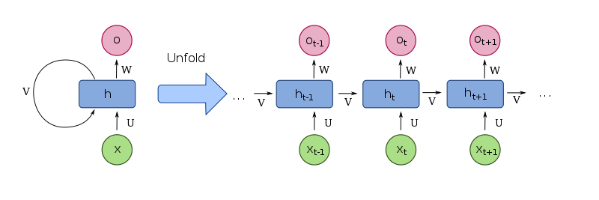
Recurrent Neural Networks
Recurrent neural networks are a special flavor of neural networks that have a memory built in.
It takes the input from a previous state of the layer, and uses this input to calculate the current state
The weight of the recurrent neuron is multiplied by the previous state, then added to the weight of the input neuron multiplied by the input.
This is placed into a tanh activation function, this is state is then multiplied by the output weight
This is repeated for the number of required steps until the final output step is calculated
Back propagation following the same process updates the weights for each process

Slide 9
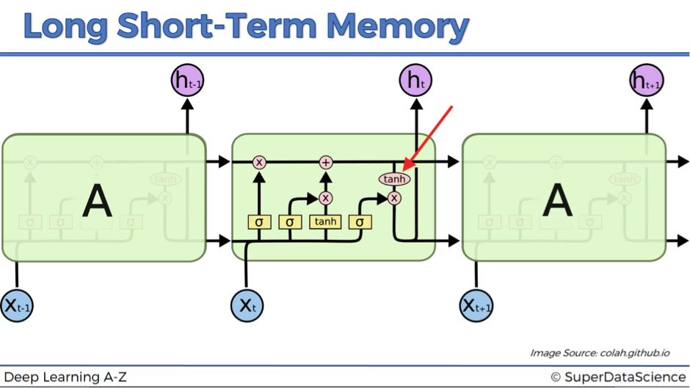
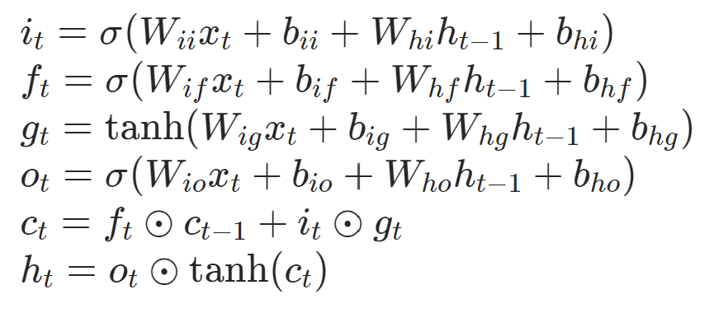
Long-term Short Memory Networks
Long-term short memory networks are a variation of the recurrent neural network
LSTMs are recurrent networks given the ability to take in the information using the entire historical context
At each gate, the information is calculated by multiplying the weights by inputs and the previous output state with the bias added
Filters are placed into the sigmoid activation function, cell states are placed into tanh activation function
The first part is the is the forget gate, this determines which information from the previous state is getting passed
The next part is the input gate, where new information is filtered and added to the information allowed through the forget gate
The filtered previous cell state is added to the filtered current cell state to create the new cell state
The final part is the output gate where the new cell state is used to determine the final filtered output state
The output state and the cell state will be delivered to the next step

Slide 10
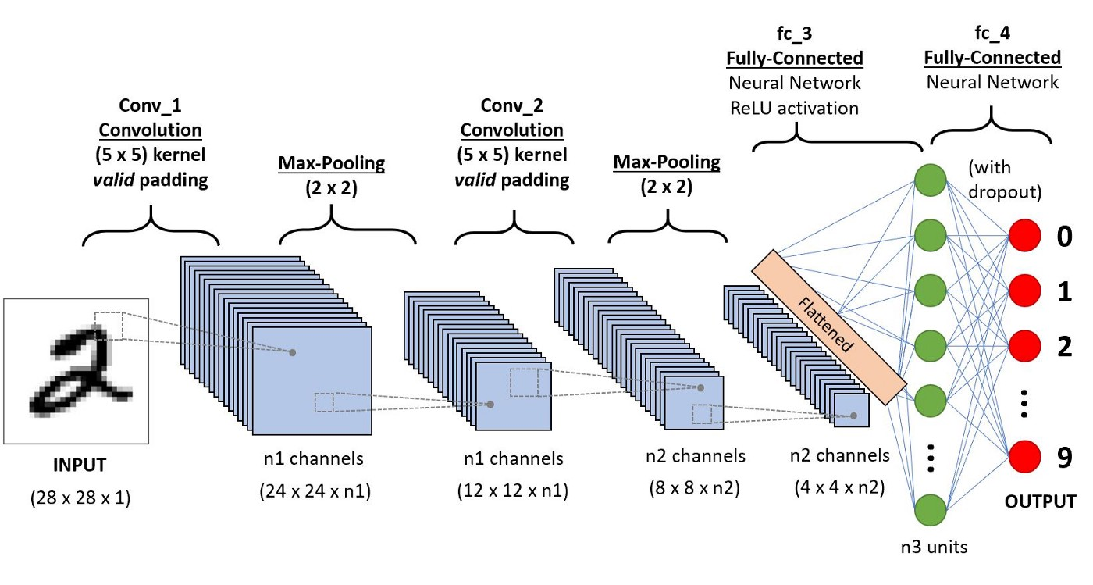
Convolutional Neural Networks
An image is technically a 2 dimensional array where each value is a pixel intensity, and a dataset of images are numerous 2 dimensional arrays of pixel intensities
Convolutional neural networks are able to efficiently extract information from a 2 dimensional array and form a concise input to be placed within a fully connected neural network
Convolutional filter is moved across the pixels of the raw image, and is condensed
It is then sent to the max pooling layer where the image is further condensed by aggregating the pixels from the convolutional layer
These preprocessed inputs are then flattened into a 1D input, and fed to a fully connected neural network hidden layer
This is then sent to the output layer and an output is created
Back propagation is then executed and the weights are updated

Slide 11
Convolutional Neural Networks
The convolution filter is a small square matrix of numbers catered for identifying certain qualities of an image
A window of image pixel values the size of the convolutional filter is chosen at a particular starting position
A dot product is created from the convolutional filter and the window of image pixel values
The window shifts is a particular direction by a number known as a stride, and the next dot product is found
This process is repeated until a feature map of dot products is created
Padding (0 values pixels at the edge of the image) can be used to allow a filter of a certain size to be properly used on the image
An activation function is then applied to each value in the feature map

Slide 12
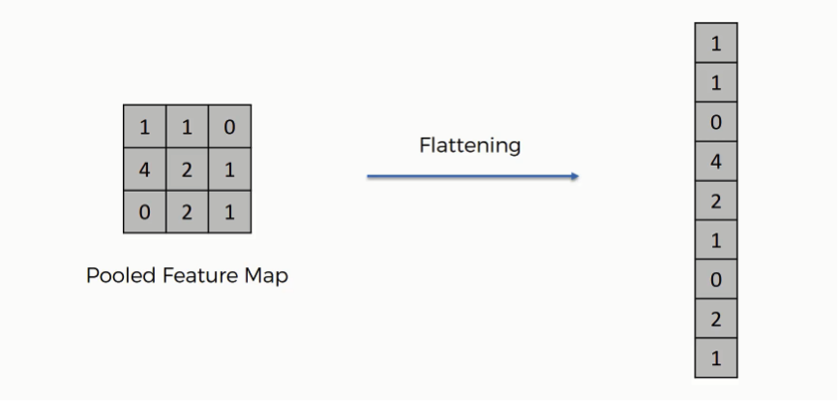
Convolutional Neural Networks
The feature map is then sent to a pooling layer, where a window of features from the feature map is selected, and these features are then aggregated through a chosen operation (example max of the features in the window)
These pooled feature maps are then flattened, where each row in the pooled feature map is reshaped into a 1 dimensional input (i.e. a 3x3 pooled feature map will be reshaped into a 9x1 input for the fully connected neural network)
This input is then placed within a fully connected artificial neural network previously explored
Back propagation is performed and the weights of the neural networks are updated
The filters within the convolutional layer are also be updated during this process

Slide 13
Conclusion
This seminar was made to establish the groundwork for a strong deep learning understanding
Deep learning is an incredibly complex field with seemingly limitless topics to learn about
Neural networks go through the input, hidden then output layer where an output is used to calculate the loss
This loss then used to update the weights
CNN and LSTMs are different flavors of neural networks with different applications
LSTMs can be used for data with dependent inputs like time series
CNNs can be used to quickly extract information from unstructured data like images

Slide 14
Next Steps
Every topic within deep learning is a deep rabbit hole
Different neural network architectures (i.e. Autoencoders, and Graph Neural Networks)
Experiment with Dropout layers
Convolutional layers also come in 1 dimension for text
Different neural networks can be combined to analyze different stimuli (video analysis using LSTMs and CNNs)
Audio preprocessing can be combined with CNNs for audio analysis
There are a wide variety of loss functions, activation functions, optimizers, etc.
Bi-directional neural networks
Dropout

Slide 15
Contect Me
LinkedIn
Email: alex_b443@yahoo.com
Number: 571-263-3464
I will send out a Github Link with the materials soon

